Slide 1
Foundations of Digital Image Processing
CS 663
(Autumn 2023)
Page Merger
Prepared By:
Tanisha Chawada(23M1071)
Chanchal Gupta(23M1069)

Slide 2
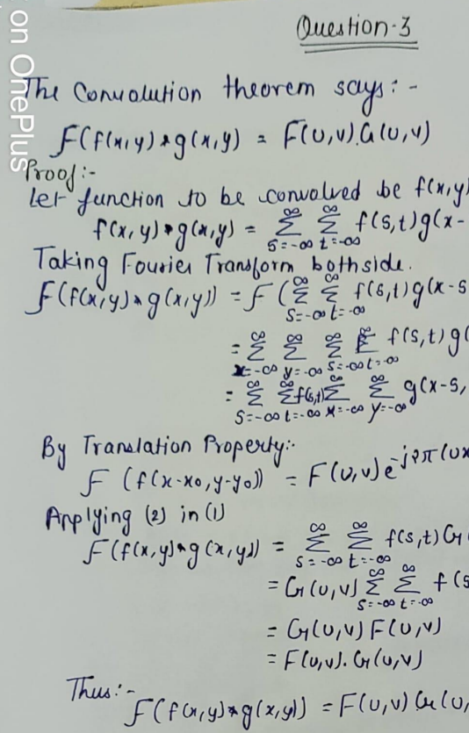
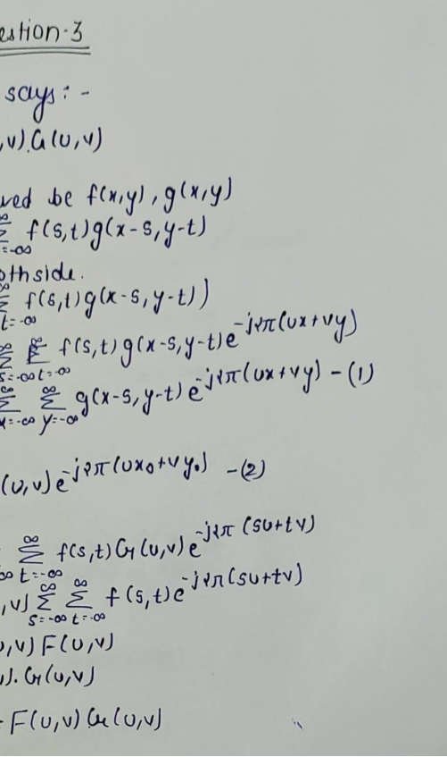
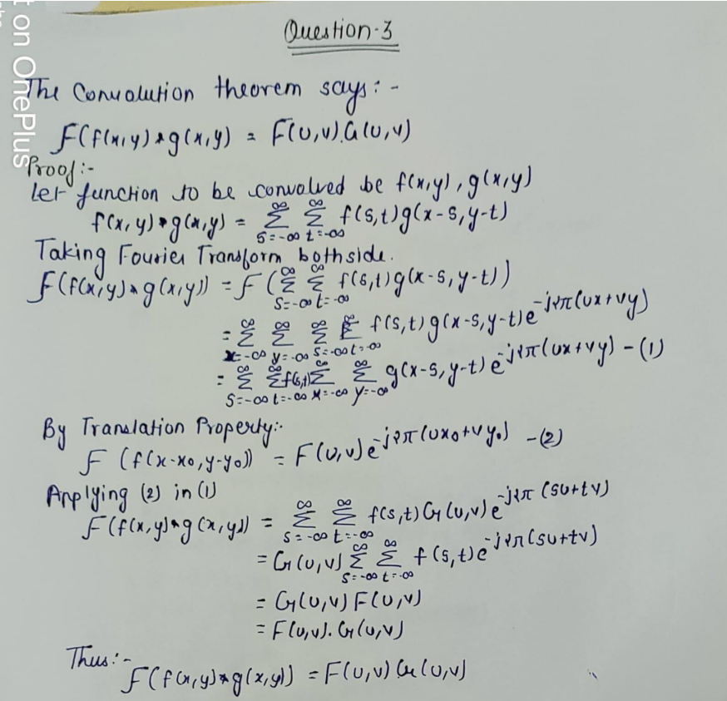
Problem Statement:
Given some images of a document and we have to combine them to make full, readable document.

Slide 3
Solution Approach:
The images are passed into an images stitching pipeline which extracts and matches the features in the images, and warps the images together.
The main steps of converting the piecewise images of a document into full image is as follows:
Input: n ordered images
• Extract ORB features from all n images
• Match the features between each pair of images and estimate pairwise Homography matrices using RANSAC.
• Find geometrically consistent Homography for each image.
• Warp each image.

Slide 4
Constraints:
Images should be taken from the same view point.
Images should have some overlapping area.
Images should be ordered.

Slide 5
Extracting features using ORB(Oriented FAST and Rotated BRIEF)
The ORB detector (Oriented FAST and Rotated BRIEF) was used to detect the features in each of the images.
Alternative to SIFT and SURF.
Its an automatic feature detector algorithm.It is resembles to the control points (manual method of feature detection in MATLAB).
ORB is rotation invariant scale invariant ,thus it is better than Harris Corner Detection Method.

Slide 6
Matching Features:
For a particular feature in image A, we can find its nearest and second nearest neighbor in image B. If its nearest neighbor is much closer than its second nearest neighbor, then the feature in image A and its nearest neighbor in image B is a good match.
In this way, we can get all pairs of matched features between each pair of two images.(We have used Brute Force Descriptor Matching algorithm.

Slide 7
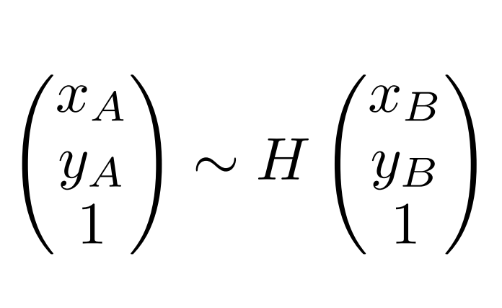
Calculating Homography Matrix
Homography is a projective transformation that maps the points in one image to the corresponding point in the another image.
It is 3X3 matrix.
Here H is homography matrix and x_{A} and y_{A} are coordinates of destination image and x_{B} and y_{B} are coordinates of reference image.

Slide 8
Calculating Homography Matrix
For calculating homography matrix ,we require at least four pair of points.
The RANSAC (Random Sample Consensus) algorithm is used to compute homography matrix.
RANSAC is a probabilistic model that predicts whether a pair is inlier or outlier.

Slide 9
Wrapping Images
After calculating the homography transformation matrix ,we need to warp the destination image according to the reference image.
By warping we mean apply transformation .
There are two ways methods to warp an image:
Forward Warping
Backward Warping

Slide 10
Result with Two Images (Input Images) :

Slide 11
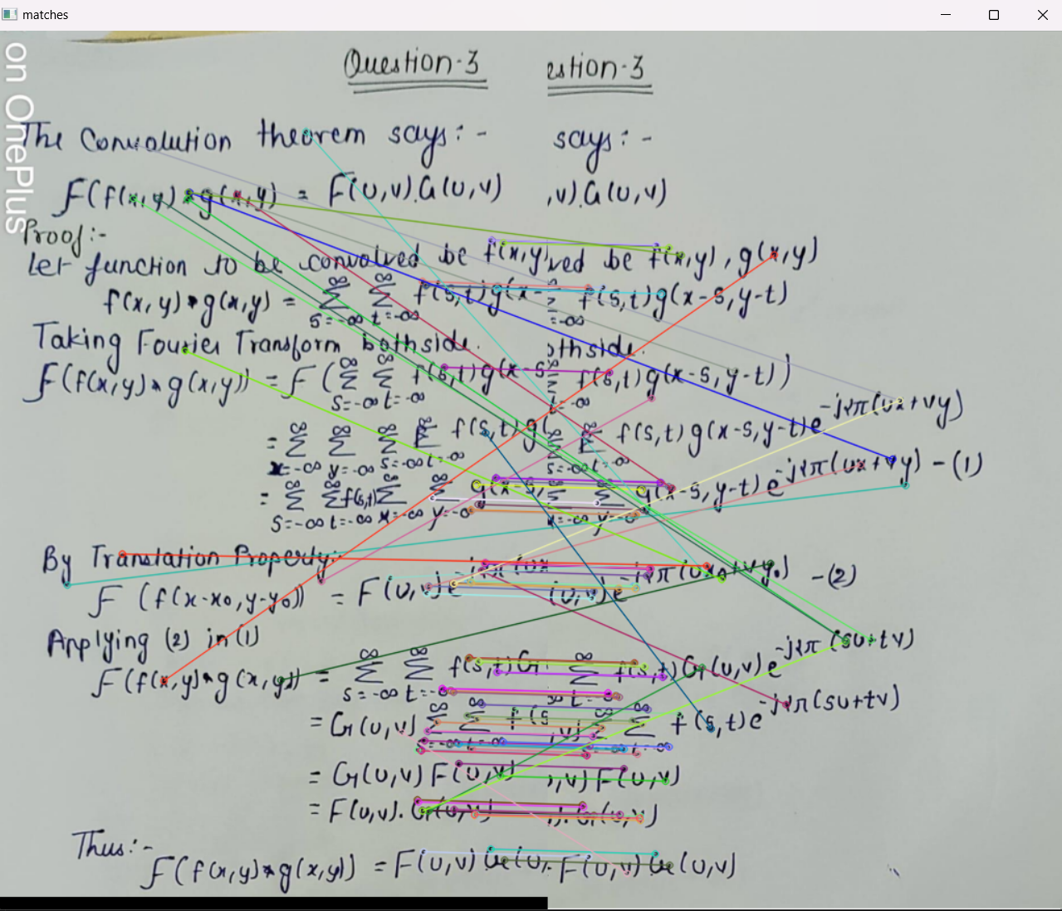
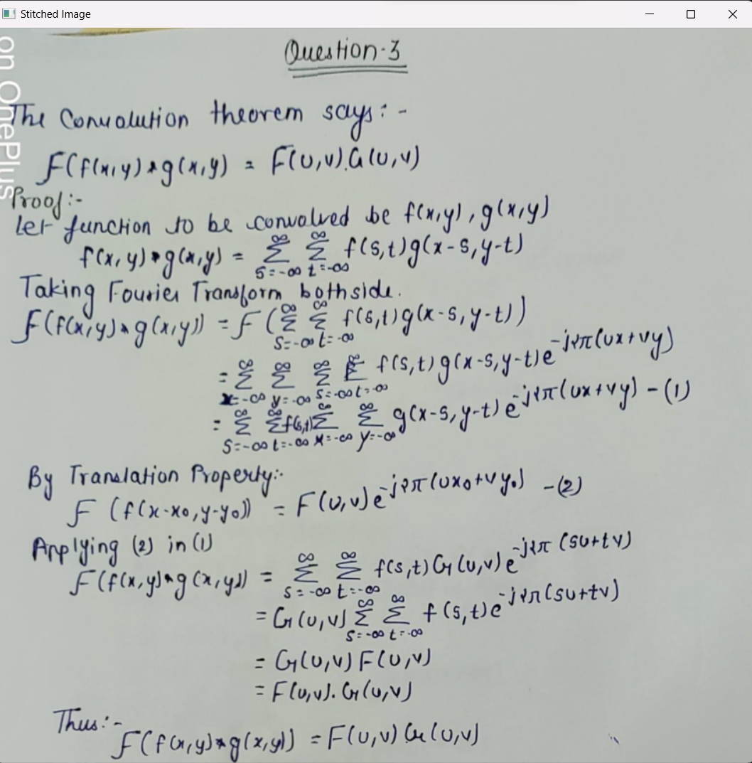
Result With two Images (Matched and Output Images):

Slide 12
Conclusion:
We have used our on data to test the code. It works well with 2,3,4 images but does not perform very well with higher number of images.

